Slide 1


WELCOME

Slide 2


Slide 3


Slide 4
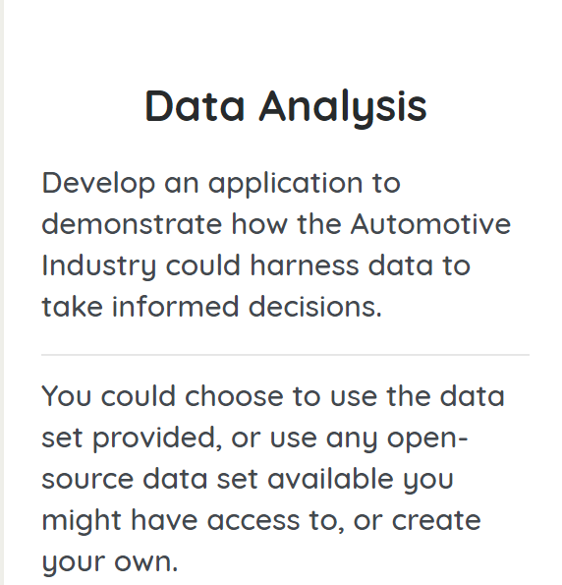

Slide 5
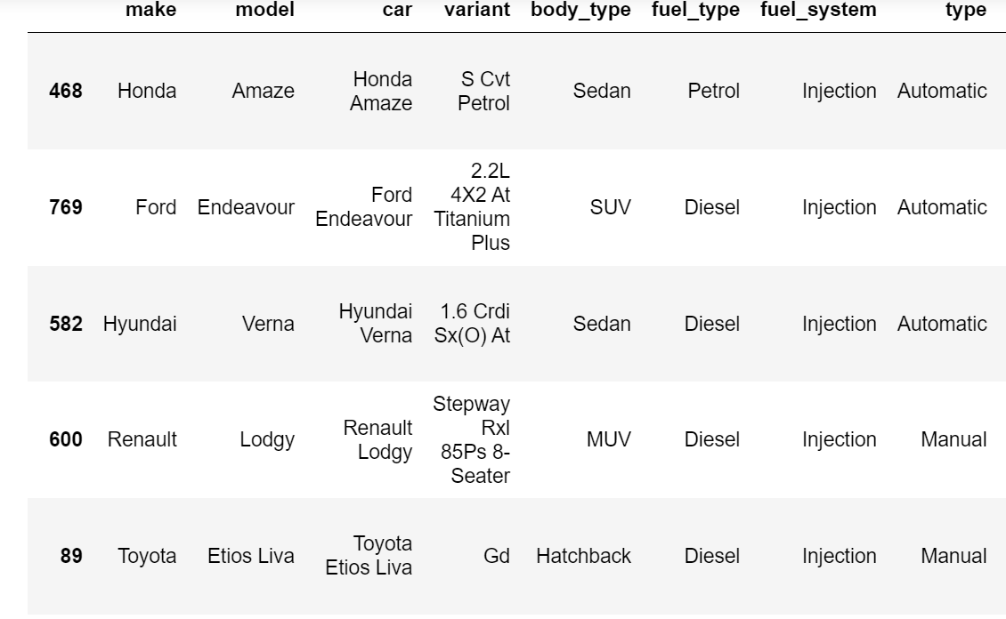
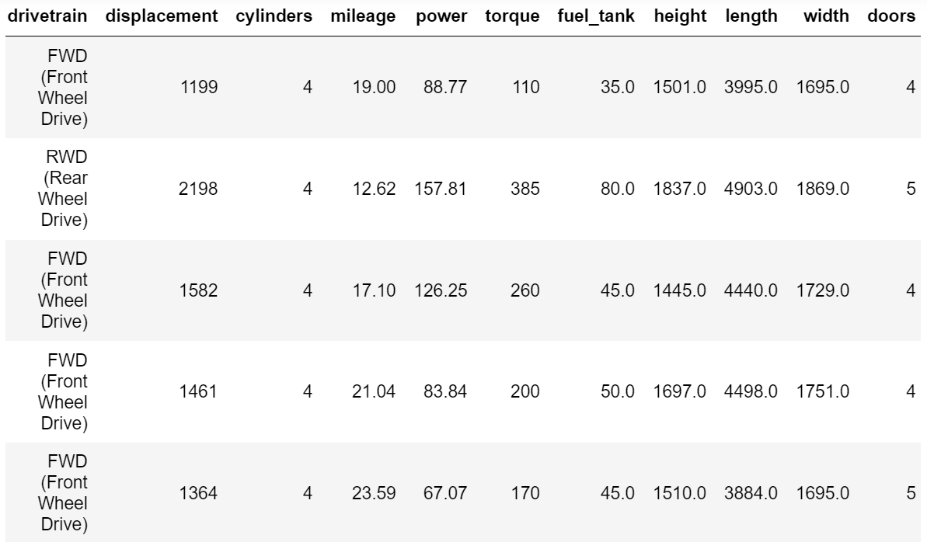
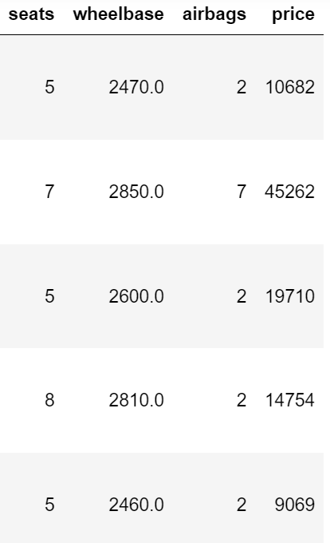

Slide 6
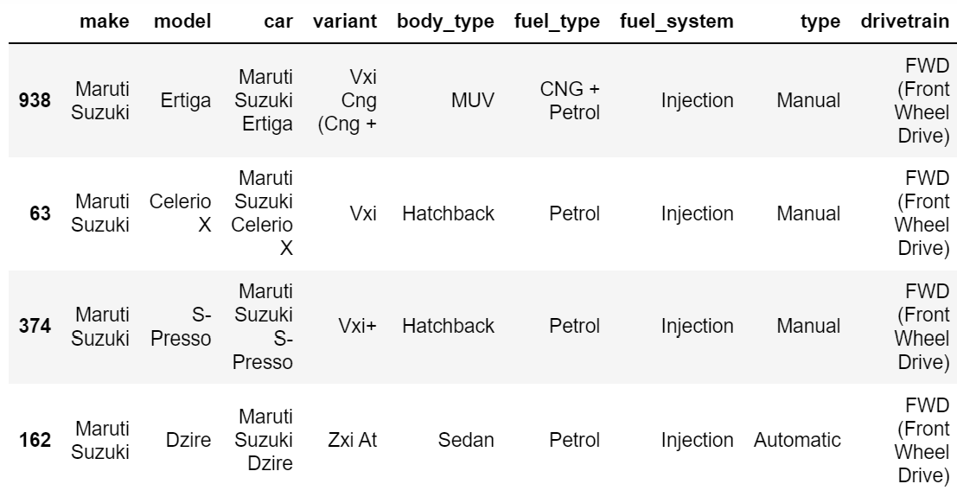
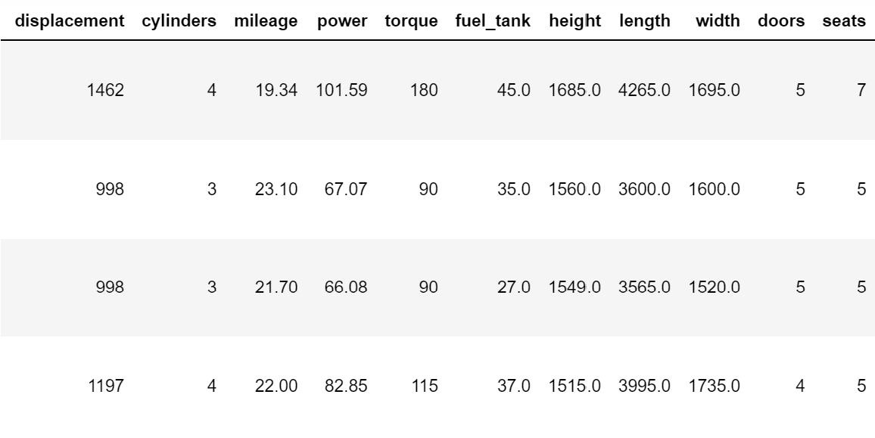
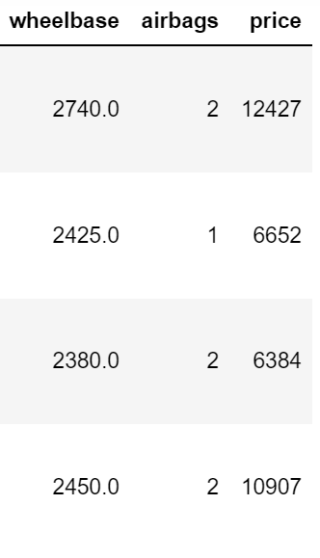

Slide 7
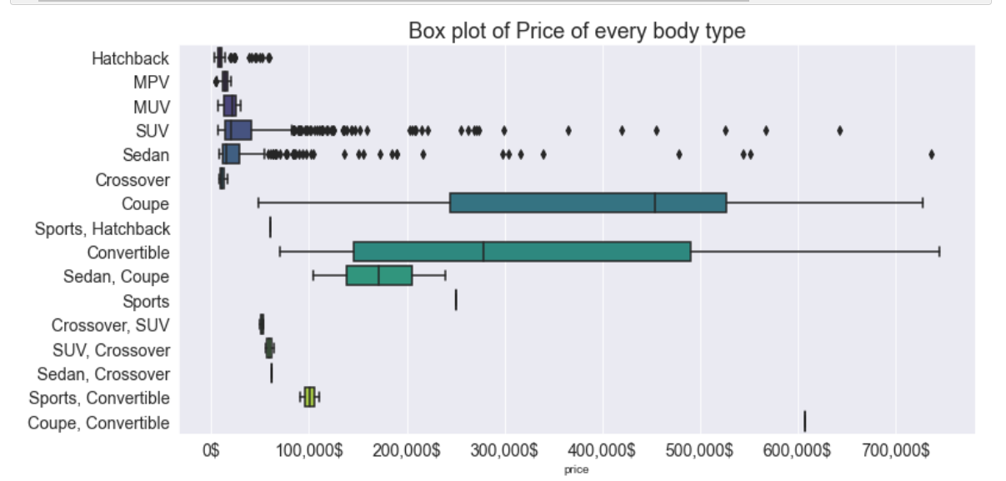
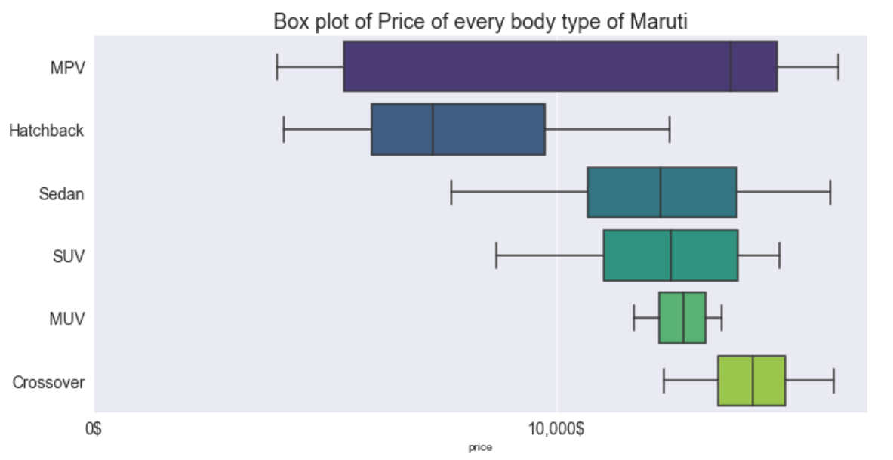

Slide 8
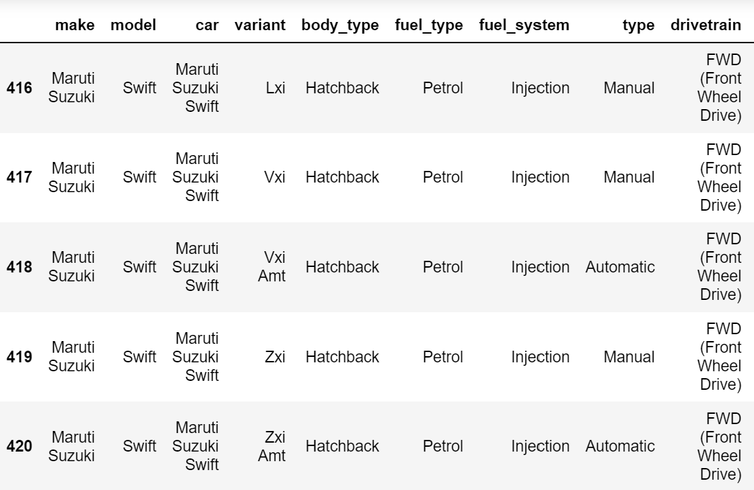
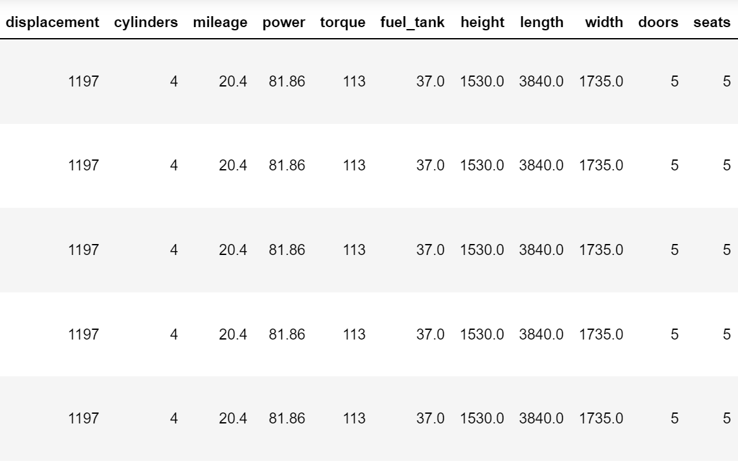
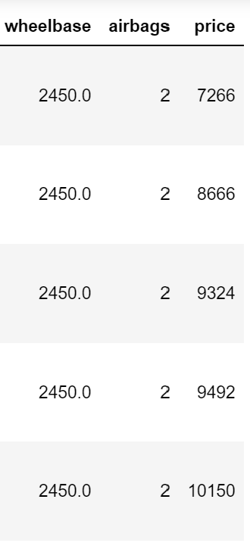

Slide 9
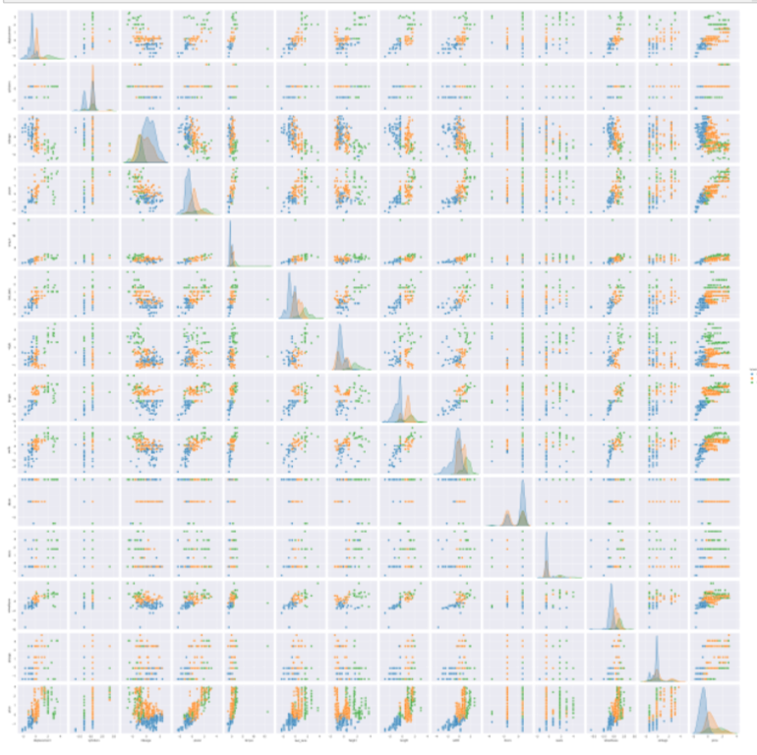
Pair plot using k-means clustering

Slide 10
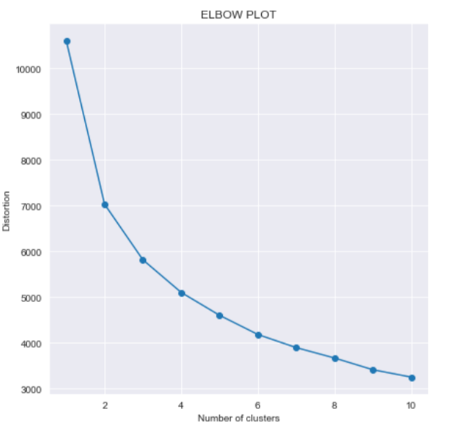

Slide 11
FINDINGS

Slide 12
1.EXPLORATORY DATA ANALYSIS
2.CLUSTERING OF CAR DATA

Slide 13
LIBRARIES USED:
PANDAS
NUMPY
MATPLOTLIB
SEABORN
PLOTLY
SCIKIT LEARN (SKLEARN)

Slide 15
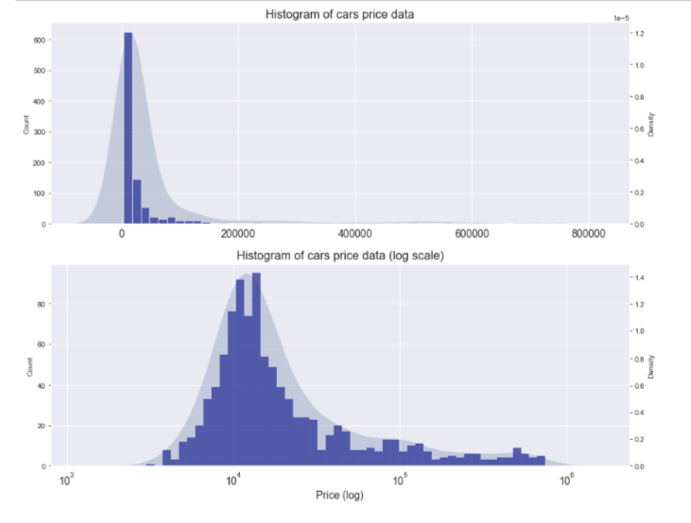

Slide 16
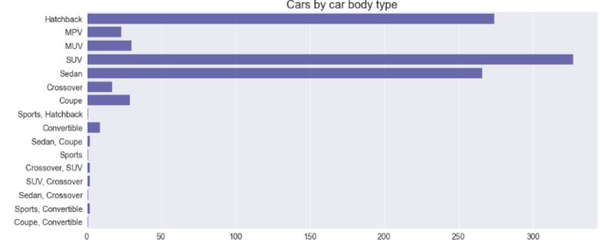
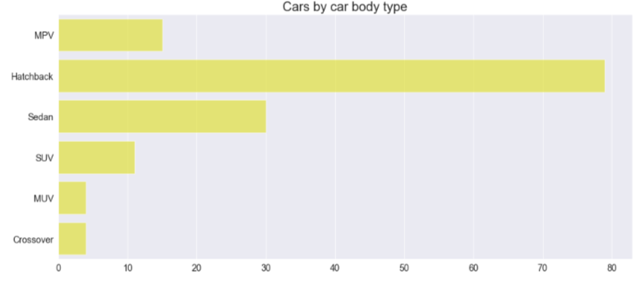

Slide 17
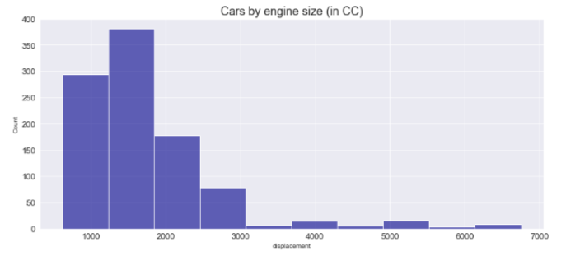
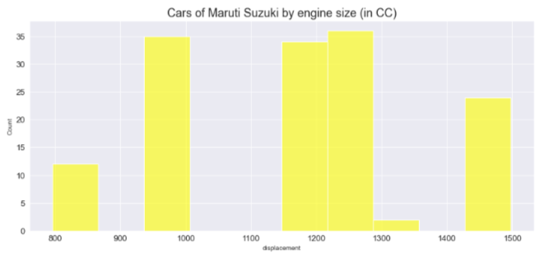
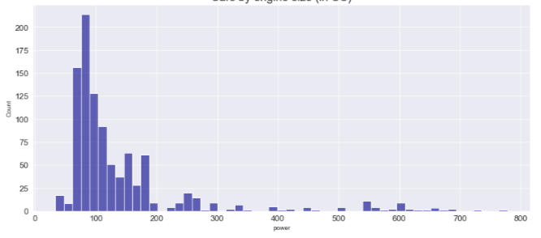
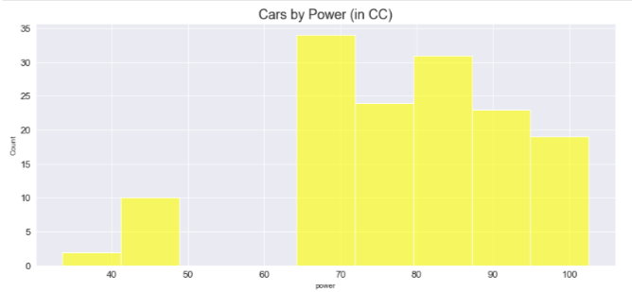

Slide 18
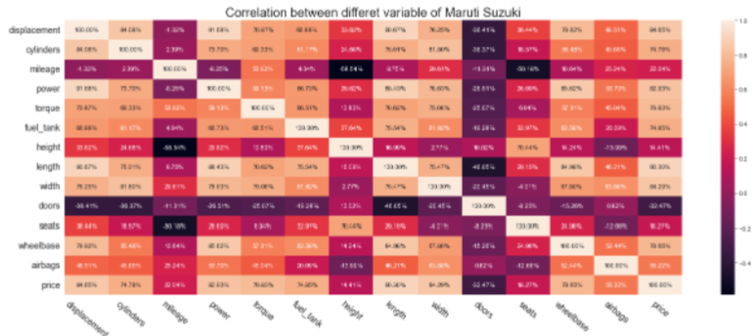

Slide 19
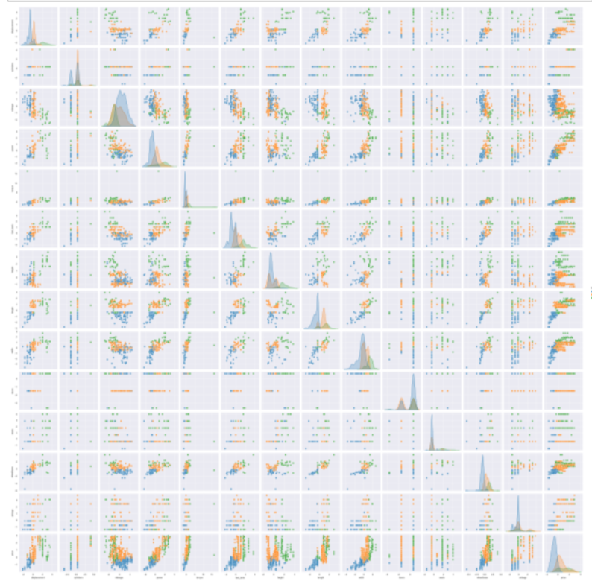

Slide 20
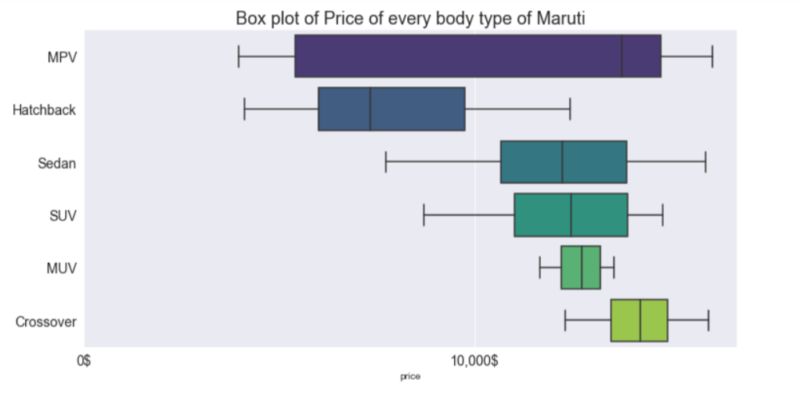

Slide 21
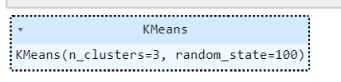
K-Means Clsutering: A technique to partition N observations into K clusters (K≤N) in which each observation belongs to cluster with nearest mean One of the simplest unsupervised algorithms Given N observations (x1,x2,...,xN) , K-means clustering will partition n observations into K (K≤N) sets S={s1,...,sk} so as to minimize the within cluster sum of squares (WCSS)

Slide 22
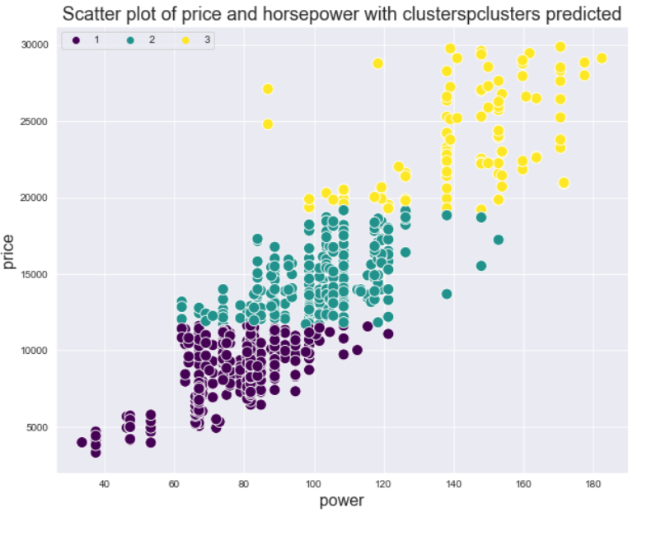

Slide 23
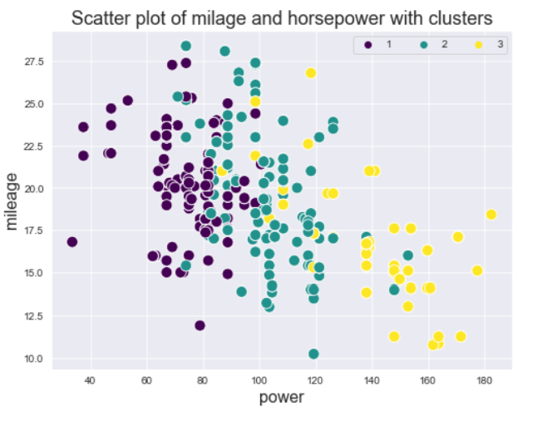

Slide 24
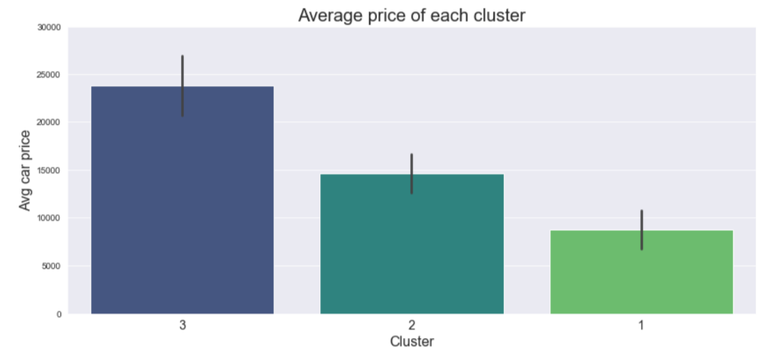
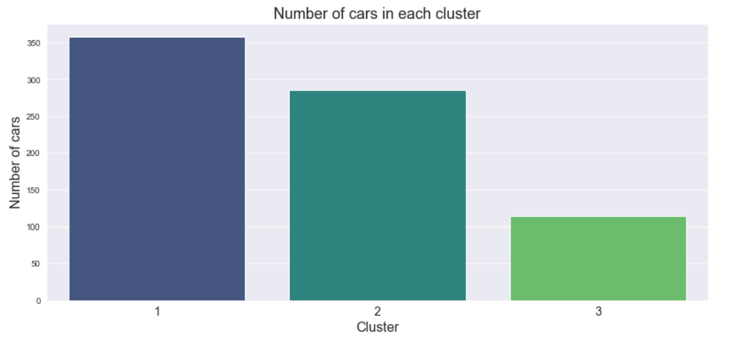

Slide 25
CONCLUSION!

Slide 26
THANK YOU!
MICROSOFT

